Slide 1
Deep Learning with tensorflow, Keras and PyTorch

Slide 2
New Networks Machine Learning and Artificial Intelligence – Part 1
Artificial Intelligence – A machine processing information to produce a desired outcome
  Goal: Achieve General Intelligence
  3 Clear Categories
    Narrow Machine expertise at a specific task ( Automatic Financial Trading Systems Recognition of objects
    General (AGI) A single algorithm that could perform well at all the tasks described
    Super (ASI) An algorithm that is more advanced then the intellectual capabilities of a human
Machine Learning – Setting up software in a say that software can recognize patterns in the data without a programmer needing to explicit dictate how the software should carry out all the aspects of that recognition
  Spend the vast majority of their time feature engineering and less on modeling
  Involves cleverly, manually processing raw inputs to extract features from data that jive well with data modeling algorithms
    Spend less time on feature engineering and more time on modeling
    Deep Learning spends more time building models that can extract features automatically
  Linear Regression, logistic regression, clustering algorithms, SVC and random forest
Representation Learning – Models are constructed in a way that provided they are fed enough data they learn features ( representations ) automatically
  features may wind up being way more nuanced as well as more comprehensive than their manually curated cousins associated with the traditional machine learning approach
    May be difficult to explain the logic behind it.

Slide 3
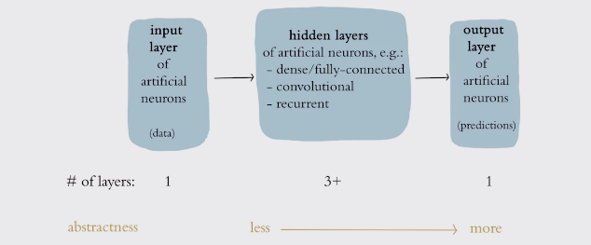
New Networks Machine Learning and Artificial Intelligence – Part 1
  Artificial Neural Networks ( ANNs) dominate the field of representation learning today
Deep Learning – An ANN that has more than a few layers of artificial neurons
  3 or more layers
  With each successive layer in the network being able to represent increasingly
  abstract recombinations of previous layers
    Fewer than a dozen layers are often efficient for learning the representations
    for a given problem
    It is not unheard of to have a 100 or 1000s of layers

Slide 4
New Networks Machine Learning and Artificial Intelligence – Part 2
Machine Vision
  Examples: Self Driving Car, Face Tagging Suggestions, Phone Unlocking via face recognition
  Relevant to any AI that that is going to need to recognize object at distance by their appearance at a distance or navigate an environment
  Convolutional neural networks ( CNN) – Architecture for Deep Learning Applications
    Generative Adversarial Network ( GAN) – Special Type of machine vision model which can produce art such as painting in the style of a master
Natural Language Applications
  Deep Learning does not dominate NLP. Beginning to overtake traditional ML approaches
  Examples: voice Recognition, Machine Translation ( Internet Searches – next word typed ),
    Relevant to any AI that interacts via Natural Language to answers complex questions automatically
  Long Short Term Memory Cell – A hidden layer ini incorporated into many Deep Learning Applications in the Natural Language Processing Sphere
    Member of the Recurrent Neural Network ( RNN)
    Applicable to any data that happens in a sequence
    Example : Financial Times Data, Traffic, Weather

Slide 5
New Networks Machine Learning and Artificial Intelligence – Part 2
Machine Learning Problems
  Supervised Learning – Goal learn function that uses X to approximate y
    Classification – Assign each instance of X into a Category Y
      Handwritten digits
      Sentiment Analysis : Input Text, Output – did they hate it
  Regression – Predicting a number
    Sales of produce
    Stock Price of a company
    Have not output to predict, but have the model learn the hidden underlying structure
      Example
        Cluster by topic
        word vectors
        GAN – Producing images in the style of famous artist.
  Reinforcement Learning – An agent takes a sequence of actions in some environment
    The agent could be a human or algorithm playing a video game or driving a car
    The agent’s actions taken by the agent influence the information the environment provides to the agent
    The model impact the underlying data. In a supervised/unsupervised never impacts the underlying data only consumes it
    Select an appropriate action to take from a scope of possibilities

Slide 6
New Networks Machine Learning and Artificial Intelligence – Part 2
Deep Reinforcement Learning
  Deep neural networks excel at process complex sensory input provide by real / simulated environments in order to instill signals from a cacophony ( A chaotic mixture ) of incoming data
Together the deep learning identifying signal from all the noisy inputs and reinforcement learning ( what decision to take ) are a powerful problem solving combination.
Deep Learning and Deep Reinforcement Learning have benefitted from
  Large Data Sets
  Parallel Computing ( GPUs)
  Research Ecosystem that bridges academics / industry

Slide 7
Visual Introduction to Deep Learning Two
Back Propagation – Facilitates efficient learning throughout the layers of artificial neurons
LeNet-5 – Detect Numbers
  Input Image of a number
  1st Layer
    Large simple features
  As we move deep then smaller more complex features
  Output layer – Probability for each digit
  Had a larger high quality training set
Employed rectangular filters
  Rectangles filters were passed over a facet that generated features which could be fed int ML Algorithms
  First Real Time Fact Detector use in cameras for auto focusing
  Weakness cannot predict a specific face such as President Trump
  Also would require year of collaboration to identify dogs, cat, fish etc..

Slide 8
Visual Introduction to Deep Learning Two
Imagnet
  Had an immense catalog of image data which contains ten of millions images
  Host a competition to use the image to find the state of the art machine vision algorithms
  Many image are of dogs so can be both generalization across different image types ( dogs, cats) or specialized ( only dogs )
  2012 was the first time a deep learning entered the ILSVRC Result and the error rate was statistically significant
    Kick Started the Deep Learning Revolution
    Artificially expanded the data available by applying transformations to the images
    Processing Power ( computer per cost went down ) – they has better efficiency at training
    Architectural – Had more layers and a new artificial neuron
Deep Learning reduces the subject matter expertise for building accurate, predictive models
  The model learned what features it should be looking for automatically

Slide 9
Running the Hands On Code Examples in Jupyter NoteBooks
!pip install tensorflow=2.0.0-beta
!pip freeze | grep tensorflow
GPU tend to be the faster then TPU accelerators

Slide 10
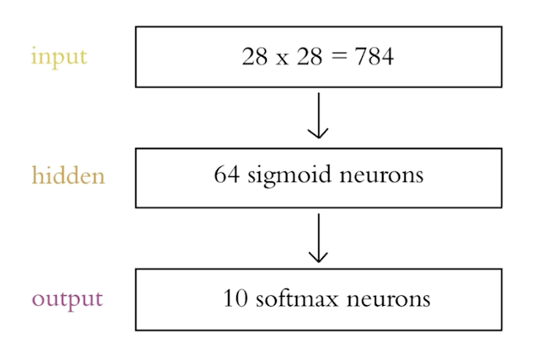
An Introductory Neural Network with Tensorflow and Keras – Part 1
MNIST Data Set
  Handwritten numbers
  Small enough to be modeled rapidly
  Samples are Diverse and Complex
    They are not easy for a ML Algorithm to identify with high accuracy
  A well designed neural algorithm will have very high accuracy.
  All images ( 28x28 bits ) with a 8 bit grey scale
We will have two sets – Test Set of 60,000 and a Validation set for performance of 10,000
Architecture that will be used is on the right
  Output will be probability for each digit ( 0 - 9 )
  Not actually a deep learning architecture since we have one hidden layer instead of three
    shallow architecture

